Slide 1

Deep Reinforcement Learning for Financial Markets Trading
Ankit Rawat

Slide 2




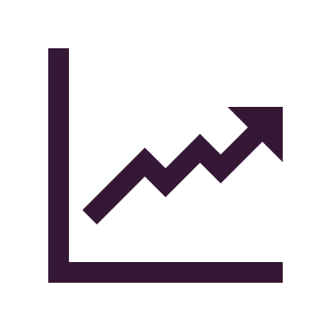
Content
Research Design
Methodology
Data
Results
Conclusions

Slide 3



Overview
Motivation
Method
Main Contribution:
Purpose of the project
Deep Reinforcement Learning
Building, extending OpenAI Gym environment
Comparison

Slide 4
Research Design

Slide 5
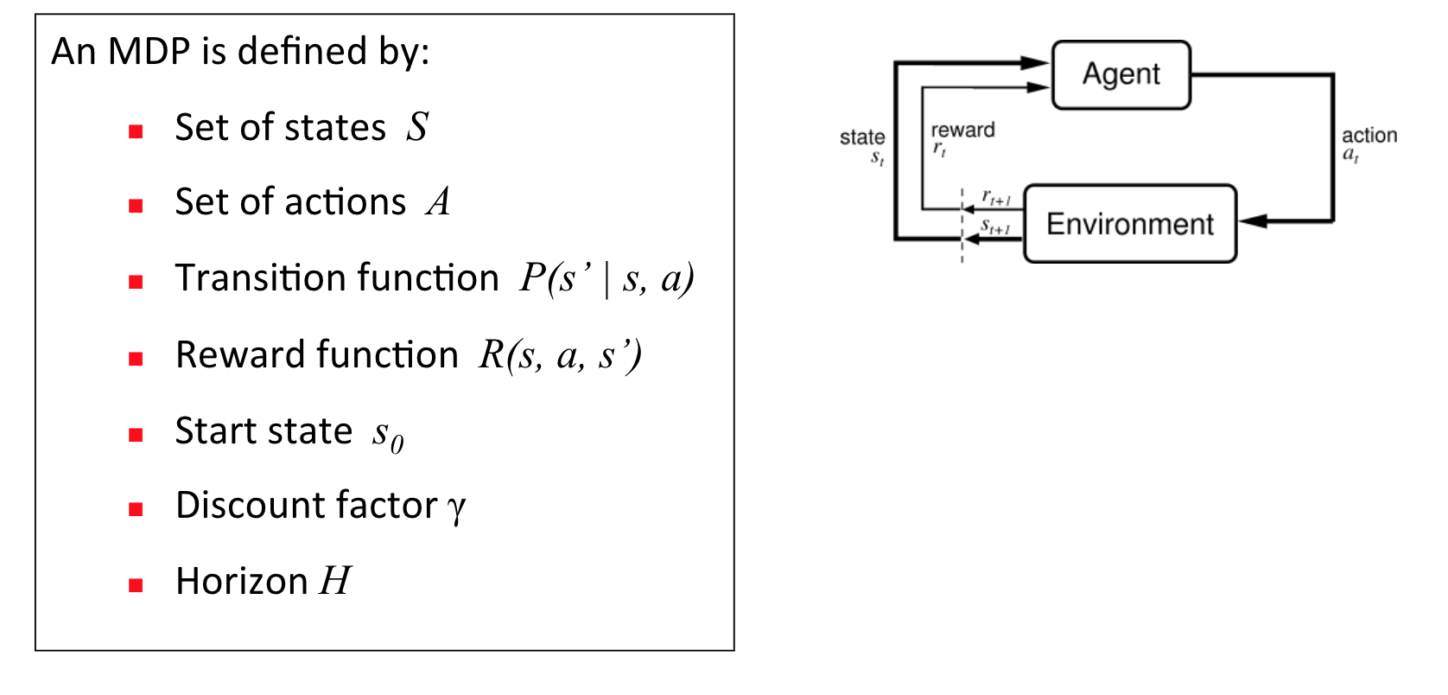
RL & DRL Framework
Reinforcement Learning = Learning from “solution”
DRL = RL + Deep Learning
Notes:
Algorithm to approximate the policy in RL is not scalable to complicated problems. DRL exploits the power of Deep Neural Network to do this task.

Slide 6
Environment
Action Space
Continuous (-1 to 1)
State Space
1D (Balance, Close, Holding, TAs)
2D (Vector of 1D across time)
Reward Function
Current Portfolio Value
PnL
Stop-Loss Average
Stop-Loss Percentage
Sortino

Slide 7
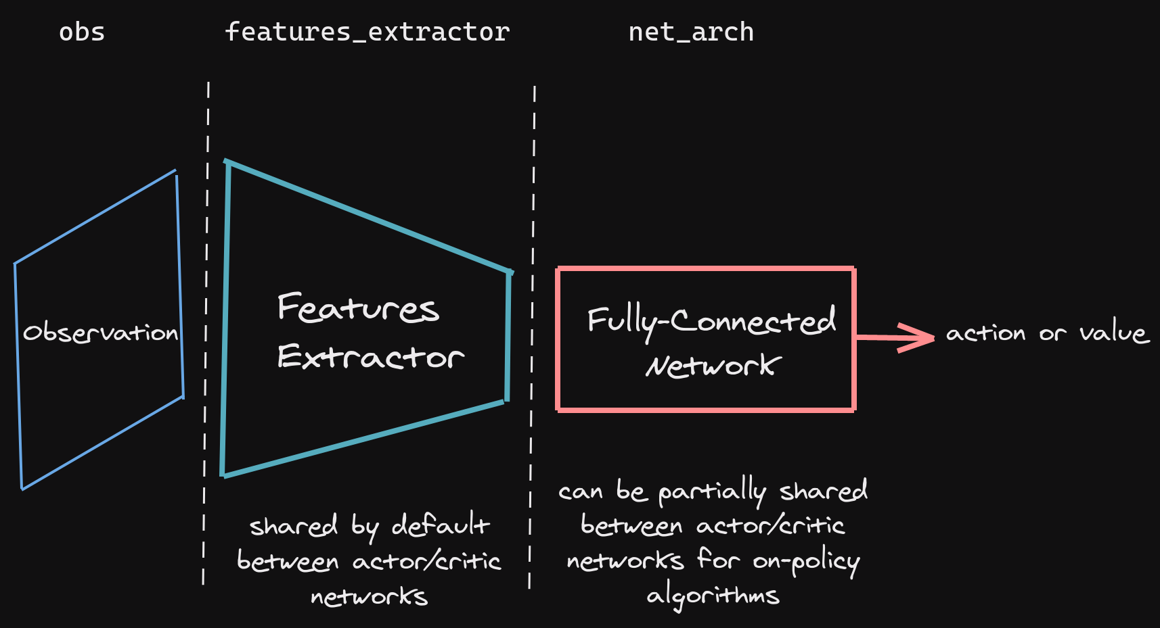
DRL Framework

Slide 8
Data
Linearly interpolate missing minute data
Train from 2008-01-01 19:00:00 to 2008-08-31 20:19:00 = 243 days
Validate from 2008-08-31 20:21:00 to 2008-12-14 00:20:00 = 104 days
Test:
Uptrend market: 2009-04-15 22:59:00 to 2009-06-24 09:38:00: 69 days
Downtrend market: 2009-01-01 18:59:00 to 2009-03-12 05:38:00: 69 days

Slide 9
Methodology

Slide 10
Project Flow

Slide 11
States (Inputs)
1D
State_1 =
Balance_1 | Close_1 | Asset_1 | MACD_1 | RSI_1 | … | CCI_1
Balance_1 | Close_1 | Asset_1 | MACD_1 | RSI_1 | … | CCI_1
Balance_2 | Close_2 | Asset_2 | MACD_2 | RSI_2 | … | CCI_2
2D
State_n =
...
Balance_n | Close_n | Asset_n | MACD_n | RSI_n | … | CCI_n

Slide 12
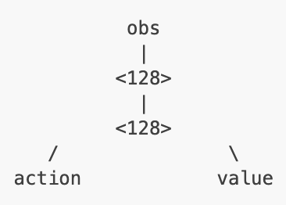
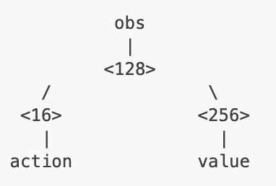
Feature Extractors
Can be either MLP, LSTM, CNN depends on the State
1D State → MLP
2D State → LSTM
3D State → CNN
Can have shared layers and seperate layers for Actor and Critic

Slide 13
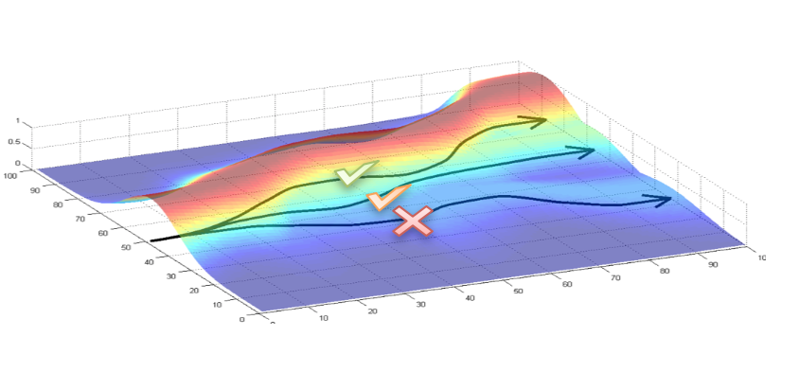
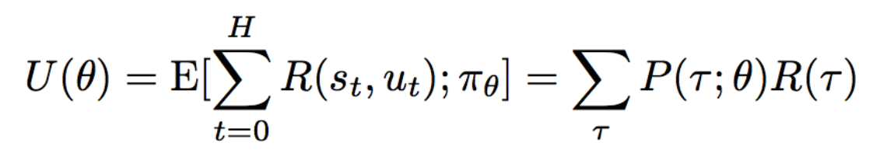
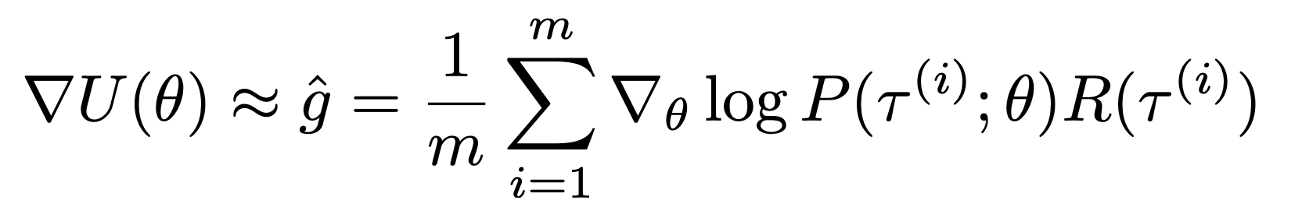
Policy Gradient
The gradient is trying to:
Increase the probability of paths with positive reward
Decrease the probability of paths with negative reward
Notes:
PG-based algorithms involve a neural network that directly outputs estimates of the probability distribution of the best next action to take in a given state.
The gradient is trying to increase probability of path with positive advantage, decrease the path with negative advantage
For example: I can play the trading games multiple times, each time ended up with different amount of profits. I will want to increase the probability of taking more profitable paths

Slide 14
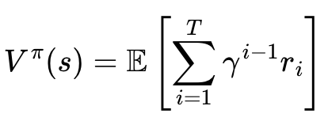
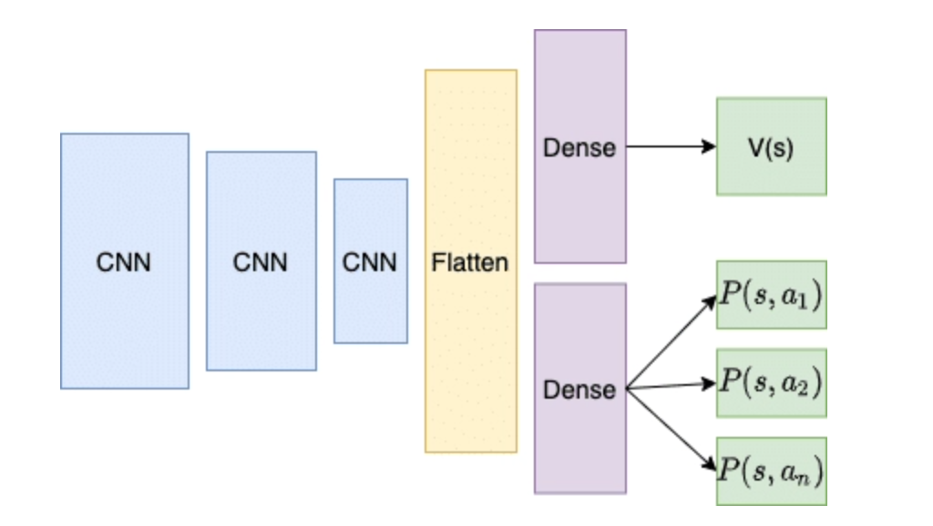
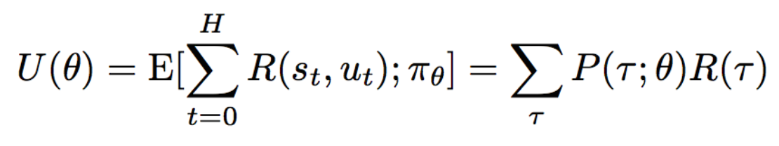
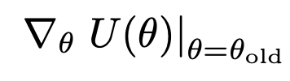
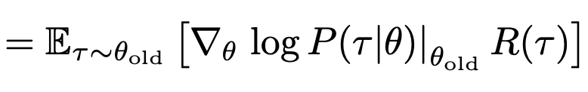

Actor and Critic Network
Critic
Actor

Slide 15

Sampling Efficiency
TRPO has a constraint on optimization: the probability distributions of old and new policy should not be very different
TRPO is very slow to converge. PPO removes the constraint, and clip the loss to avoid large gradient updates:

Slide 16
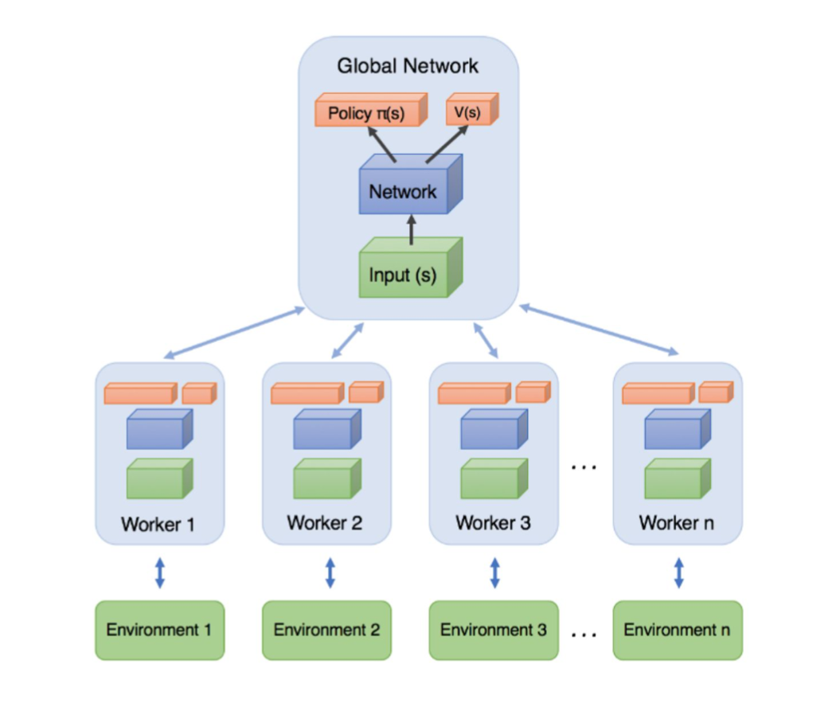
PPO with multiprocessing
Environments are generated with different seeds. Same settings
Each environment is run on 1 core
This helps the model the sample more paths, reduce the variance, learning more given the same training time

Slide 17
Reward Functions
Reward Function | Formula
PnL | End Total Asset - Begin Total Asset (equivalent to (Close_{i+1}-Close_i)*Current_Assets
Stoploss_avg | PnL- stoploss_factor * Stoploss_Penalty
Stoploss_2way
Sortino | Stoploss_2way + sortino_factor*Sortino_Ratio

Slide 18
Stop-loss Penalty
Stoploss_avg: if price falls below 2 stddev from the mean of previous close prices, penalize the reward by
If (Close < Mean - 2 x Std):
stoploss_penalty = stoploss_factor * (Close - Mean)*Current_Holdings
Stoploss_2way: if price is more than 2 stddev away from the mean of previous close prices, penalize the reward.
If (Close < Mean - 2 x Std) or (Close > Mean + 2 x Std):
stoploss_penalty = stoploss_factor * (Close - Mean)*Current_Holdings

Slide 19
Hyperparameter Tuning
Learning Rate
Max Trading Amount
Reward Scaling Factor

Slide 20
Results

Slide 21
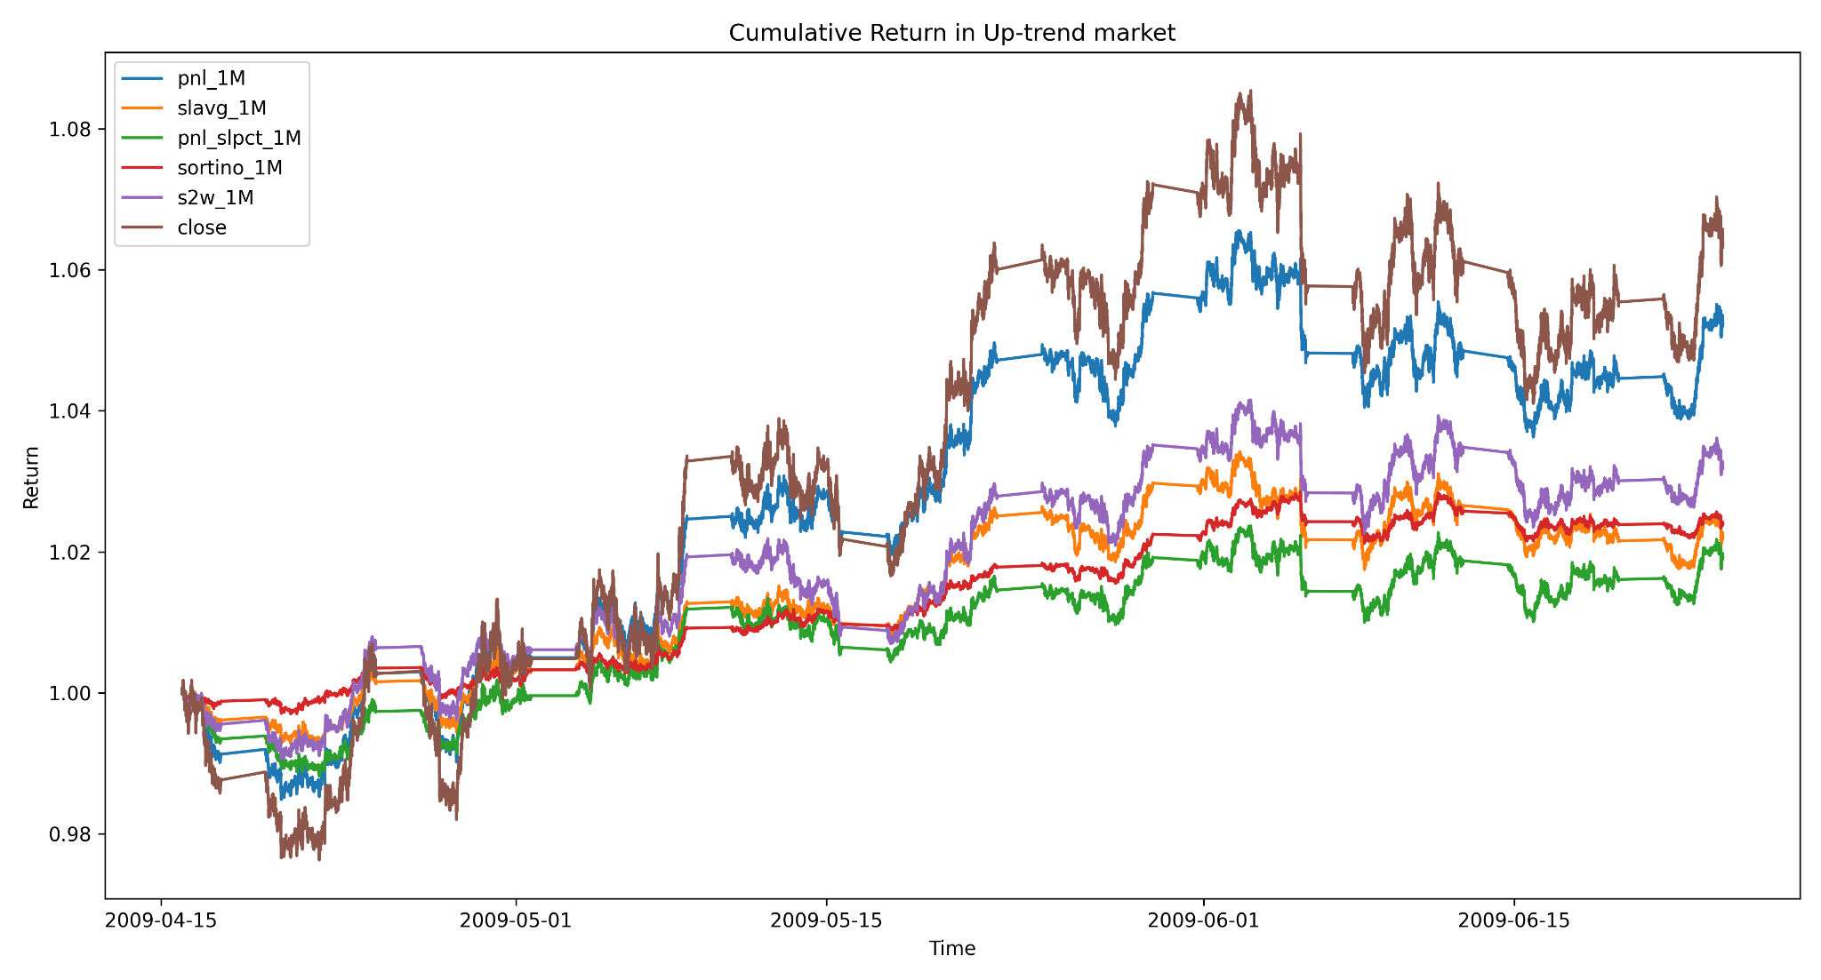
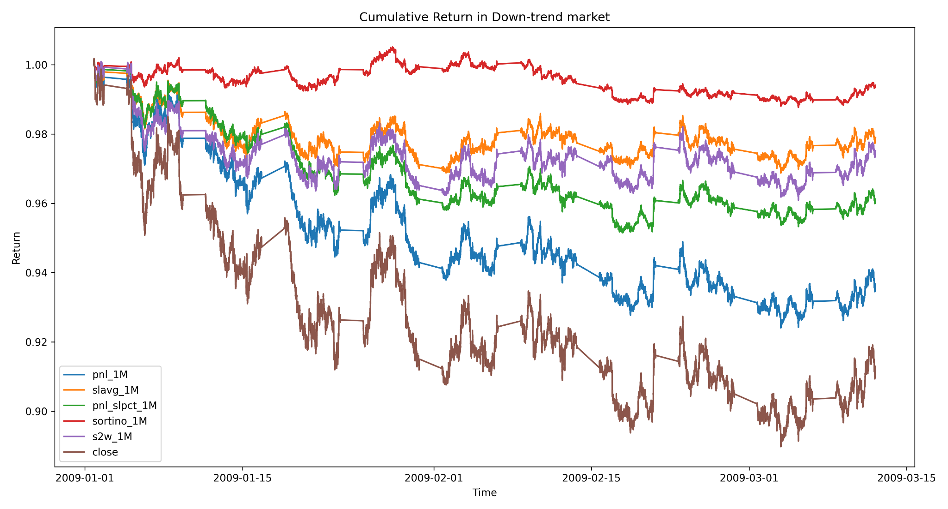
Results - Reward Function

Slide 22
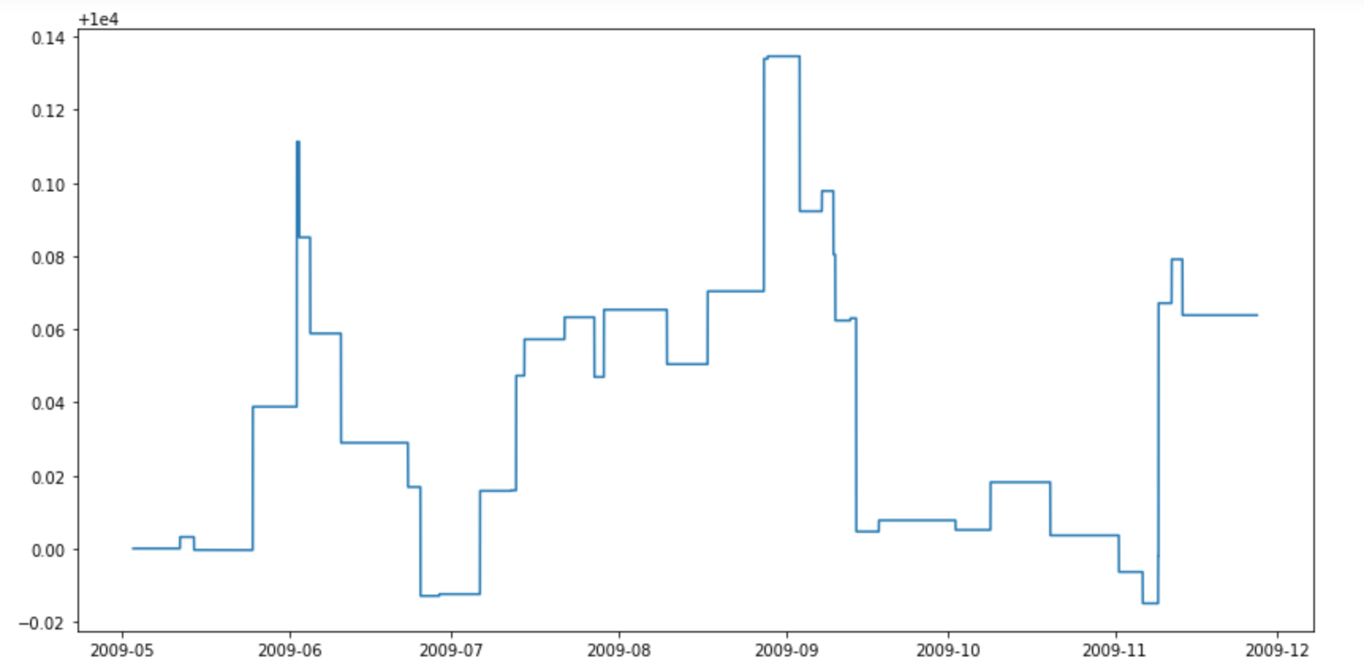
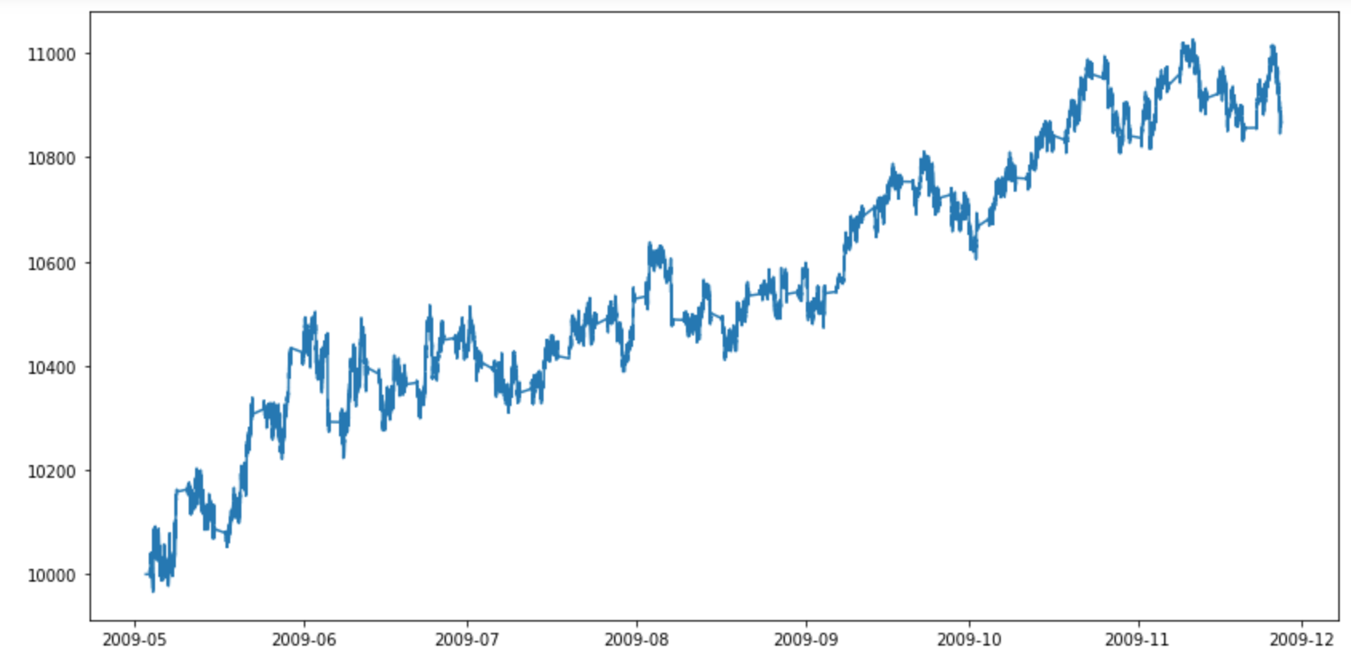
Results - Learning Rate
LR=0.003
LR=0.0003
Notes:
If the lr too high, the model never converges

Slide 23
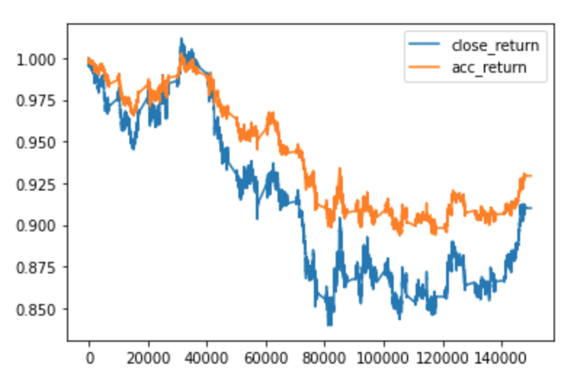
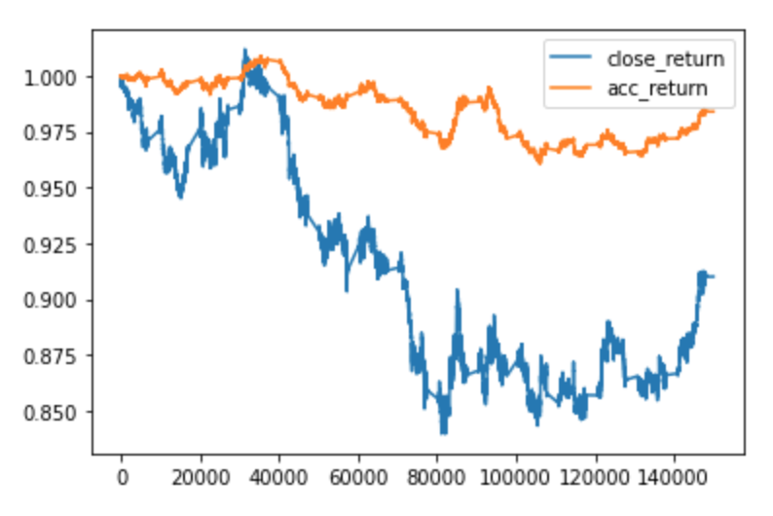
Results - Policy Network
MLP [64,64,32]
MLP [64,64]
Notes:
Deeper model is not necessarily better performance
RL tends to overfit easily

Slide 24
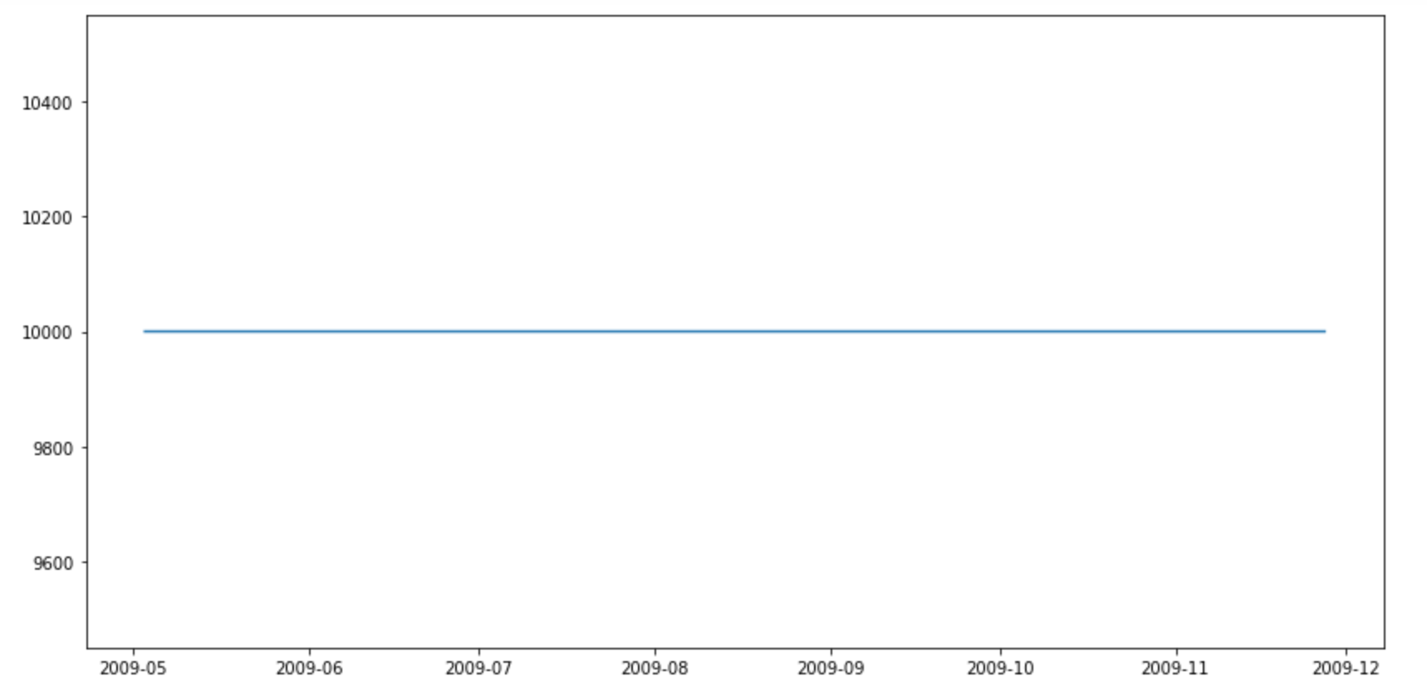
Results - Deep Learning can go wrong
obs
|
|
<128>
|
|
------- <128> -------
/ \
<64> <64>
| |
Actor Critic

Slide 25
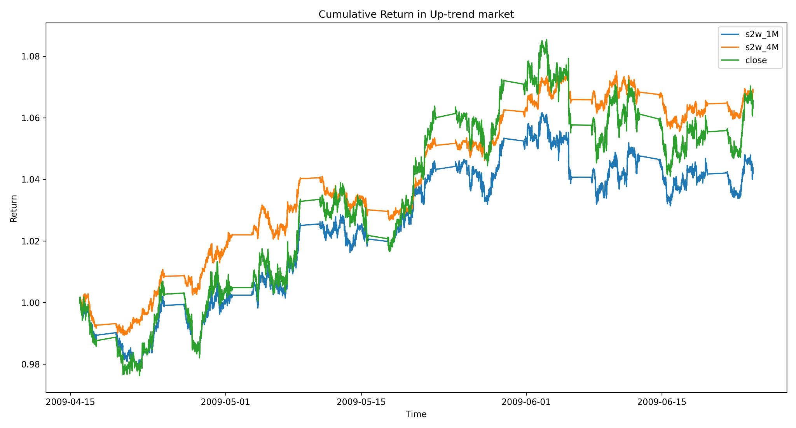
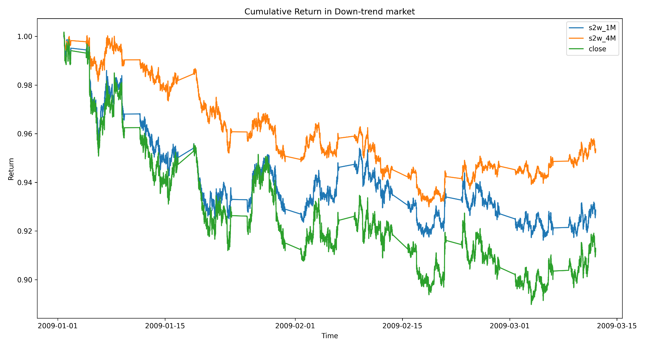
Results - Increase Training Process

Slide 26
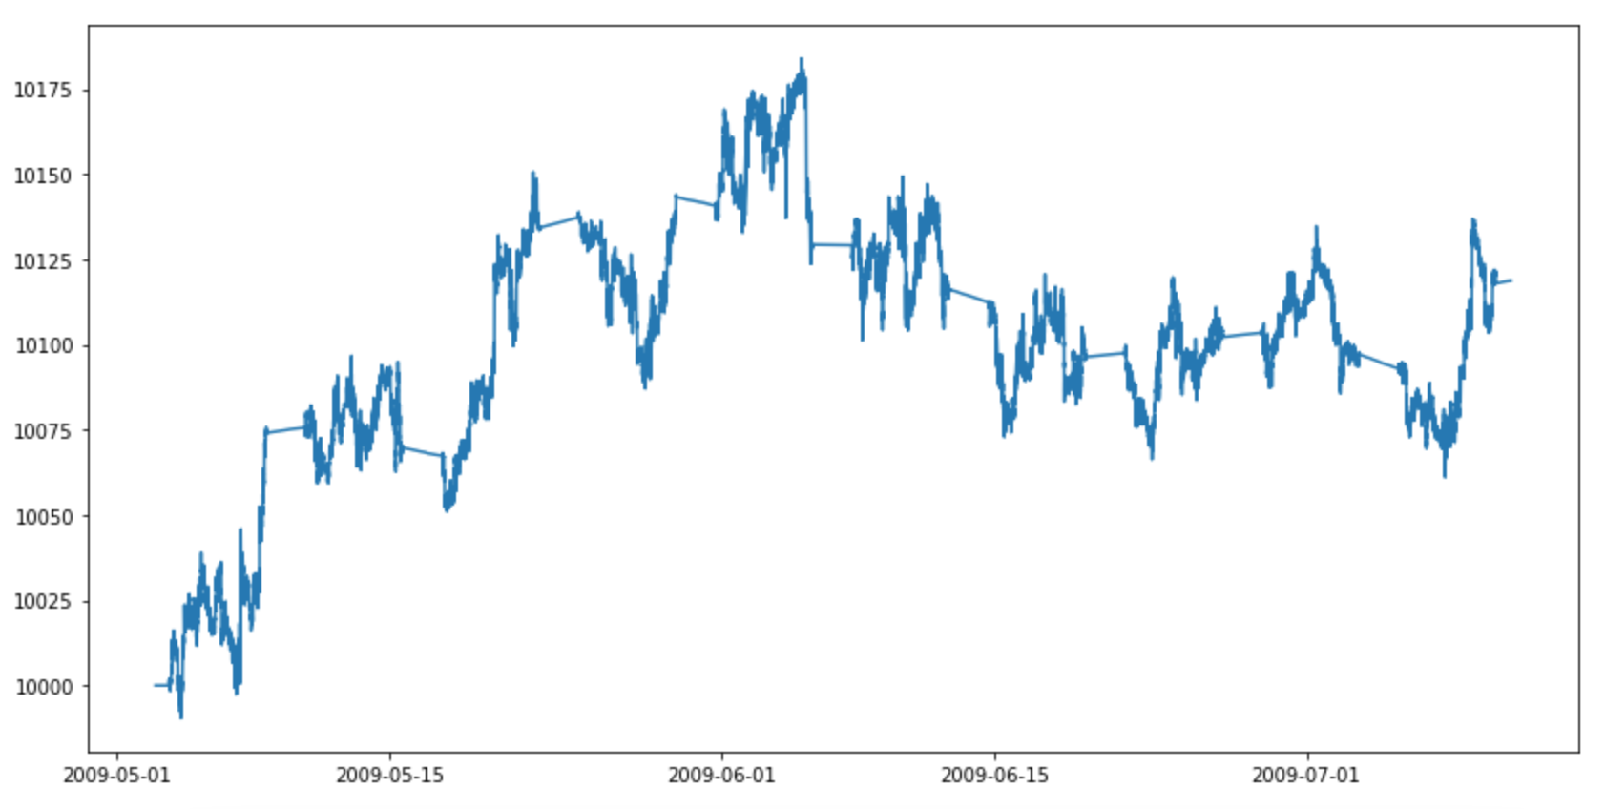
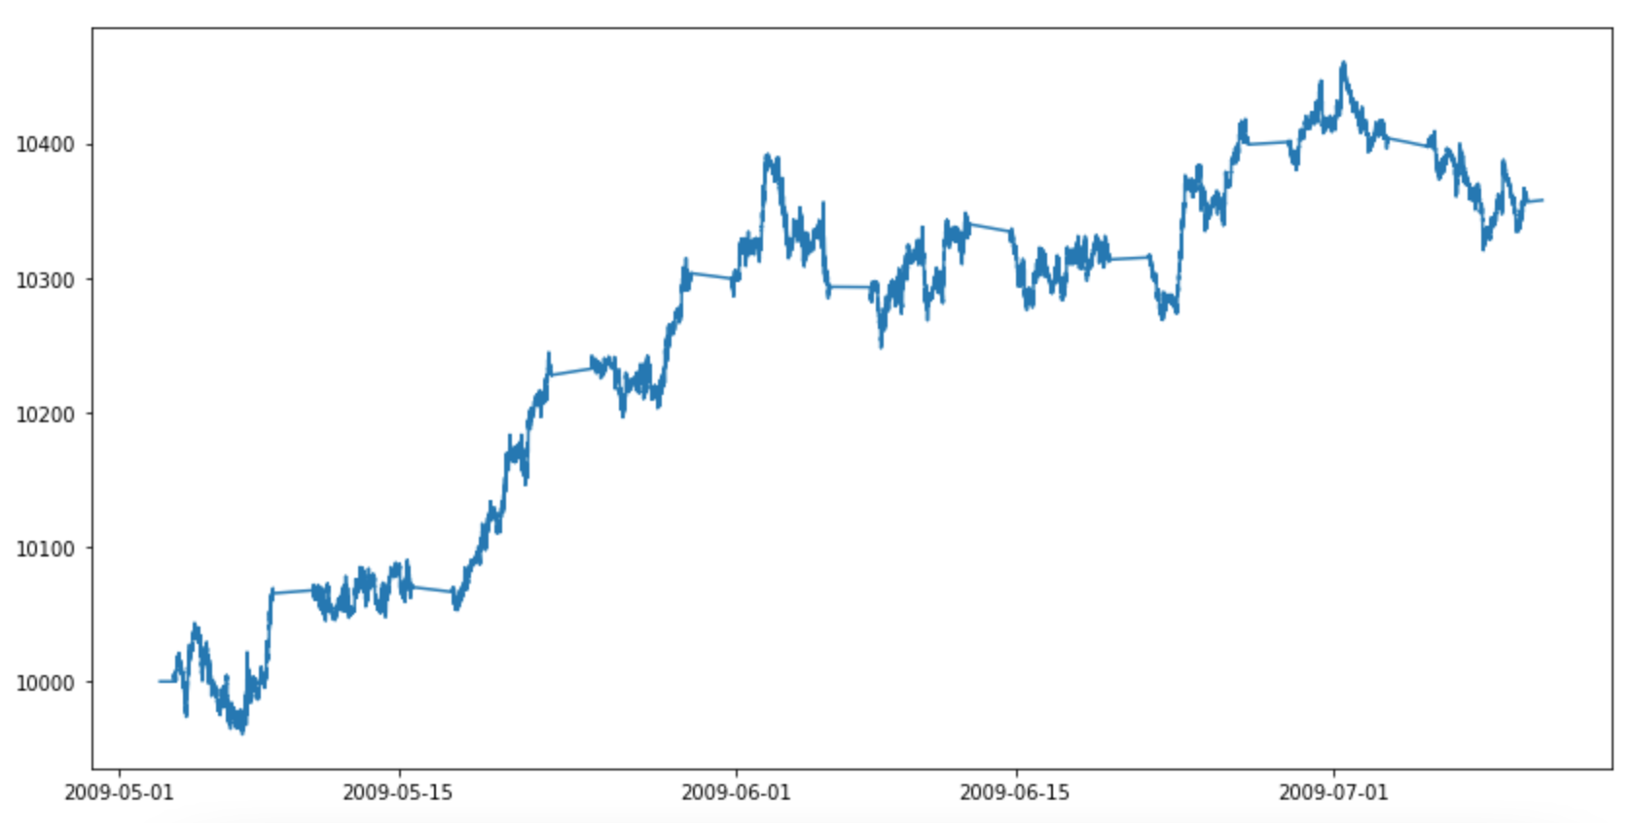
Greedy Trade
10% of initial balance
100% of initial balance
Notes:
Rather than limit the maximum amount to trade, we just let the model learn how much to trade

Slide 27
Conclusion

Slide 28

Conclusion
Main challenge: computational power
What we achieve:
We just use a tiny portion of available data. Data is not our problem for now.
I took 1H to train 350K data for 1M timesteps (about 3 episodes), and 7H to train 700K for 4.2M timesteps (about 6 episodes)
Normally, to get viable result, researchers usually train at least 1000 episodes
Difficult to have a good reward function
1D and 2D Trading environment compatible with OpenAI Gym framework. Also allow to trade multiple assets
Comparison between reward functions in different market situations. May need more domain knowledge.

Slide 29
Conclusion
 | Bull Market | Bear Market
Reward Function | PnL (End Total Asset - Begin Total Asset) | Sortino (Stoploss_2way + sortino_factor*Sortino_Ratio)
Policy | MLP Policy | MLP Policy
Max Trading | 100% | 100%

Slide 30
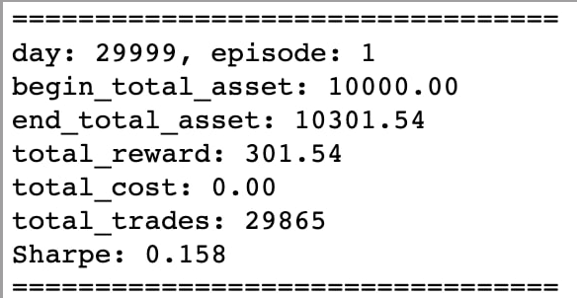
Future Work
Need to increase training process to assess if the model really works
More hyperparameters tuning
Explore 2D trading env:
Exploit Recurrent Neural Network
Test result of LSTM ( Training on 48 Days with 200k timesteps )
LSTM can only be train on 1 core currently.
Ensemble different types of DRL model
Current trained on PPO and also want to train on Off-policy ( DQN , DDPG )
Rolling trade:
Every quarter: continual training
Use the model with best Sharpe ratio to trade for the next quarter
Notes:
PPO is fast and can be trained on multiple CPU and converges fast as compares to off policy performance.

